Slide 1
SISN’s Frameworks and Classification Scheme
Version Dec 2019

Slide 2
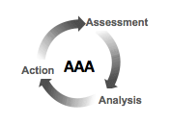
The Five Domains Whose Characteristics, Capacities, Dynamics and Fit Affect Implementation Quality
3. Enabling Environment
Policy Frameworks, Governance, Finances and Stakeholder Dynamics and Alignment Among Government, Funders, Civil Society, Private Sector
1. Objects of
Implementation
Nutrition-specific interventions
Nutrition-sensitive interventions
National policies
Emergency nutrition response
Implementation innovations, guidelines or practices
5. Implementation Processes
Initiation,
Planning, Implementation, Sustaining
2. Implementing Organization(s) and Staff
In ministries, NGOs, private sector
Implementation Outcomes
Nutritional Status
4. Individuals, Households
and Communities
Needs, Resources, Capacities, Social, Cultural, Behavioral, Economic, Political factors
(Adapted from Damschroder et al., Implementation Science 4:50, 2009)

Slide 3
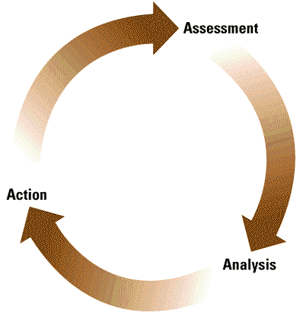
Potential Factors Within the Five Domains that Affect Implementation Quality
3. Enabling Environment
1. Objects of
Implementation
Policy Frameworks, Governance, Finances and Stakeholder Dynamics and Alignment Among Government, Funders, Civil Society, Private Sector
Assessment
2. Implementing Organizations
5. Implementation Processes
Action
AAA
Intervention/
Policy/
Innovation/
Guideline/
Practice/
(unadapted)
Core components
Peripheral components
Organizational Characteristics:
Leadership, commitment, readiness, management, competing pressures and priorities, incentives, compatibility with mission, capacity and resources to adopt, adapt, implement, support, monitor and adjust, accountabilities
Initiating, Scoping & Engaging
assessing fit and readiness with opinion leaders, formal leaders, champions, facilitators, partners
Planning
Theory of Change / PIP
Formative research
Design & adaptation
Implementation strategy
Implementation, Iterative Improvements & Scaling Up
components, sequence, intensity
duration, quality improvement,
process evaluation, operations
research, special studies
decisions and adjustments
Commitment, Support, Financing & Sustainability
continuous advocacy, networking, engagement, strategizing, vigilance, reporting and documentation
Analysis
Implementation Outcomes
Client
Outcomes
Objects (adapted)
Core components
Peripheral components
Perceived and Actual:
source, evidence, advantage, adaptability, trialability, complexity,
design quality and packaging, cost
Staff Characteristics (frontline, supervisors and managers):
Knowledge, skills, beliefs, motivation and incentives, workload, self-efficacy, stage of change, values, intellect, competence, learning style, openness, access to materials and resources, accountabilities
4. Individuals, households and communities:
Needs, resources, capacities, social, cultural, behavioral, economic, political factors
Adapted from Damschroeder et al.,Implementation Science 4:50, 2009
Notes:
Bottom lines:
The black box is quite complex.
The interactions and importance of Interventions, Context and Processes are clear.
There is an almost infinite number of reductionistic studies that could be done to: a) document the influence of each of these alone or in combination; and b) to test various ways to change some of these factors for the better. But this would take decades and would not necessarily help us in the end because these factors are all part of an interactive system so we need to understand the system, not the parts in isolation.
A more productive use of this framework is: a) to help us design implementation strategies with our eyes wide open (anticipating and addressing various barriers and enablers in advance); b) appreciate the importance of “Implementation Strategies and Processes” as THE pivotal factor for later outcomes; and c) provide some intermediate indicators that should be measured and monitored during implementation so that we can learn how they change under different circumstances.

Slide 4
SISN’s Classification Scheme of Implementation Research
 | Commitment, Support, Financing and Sustainability cross-cutting governance functions that require diverse methods for stakeholder analysis, assessment of advocacy needs and opportunities, costing, capacity assessments, coordination, etc.
Objects of Implementation | Initiation and Scoping | Planning and Design | Implementation, Iterative Improvement and Scaling Up
Nutrition-specific interventions | diverse forms of assessments, stakeholder analysis, opinion leader research and consultations to guide: agenda setting, identification of policy/ program/intervention options and their fit with a) the problem and b) delivery capacities, and c) available collaborations/ partnerships. | diverse forms of formative research and consultations (at multiple scales/administrative levels) to guide the detailed design of policies/ programs/interventions and development of detailed implementation guidelines, guided by explicit PIPs or Theories of Change. | diverse forms of operations research, special studies, process evaluation, quality improvement/quality assurance schemes and monitoring and evaluation systems.
Nutrition-sensitive actions
National Policies
Emergency Nutrition Response
Implementation innovations

Slide 5
SISN’s Integrative Framework for Implementation Science in
Nutrition
3. Contextual Knowledge and Experience (CKE)
The Goal
Collaboratively Assess, Build on Strengths and Address Weaknesses in The Five Domains in a Timely Manner During All Phases of Planning and Implementation
1. Global Knowledge and Experience (GKE): Formal Implementation Trials,
Evaluation of Innovative
Implementation Practices and Cumulative Experience
Implementation Science:
Existing and Emerging Knowledge About Implementation
Frameworks,
Tools,
Guidelines
Capacity Building,
Technical Assistance,
Knowledge Brokering,
Coaching
2. Contextual Implementation
Research (CIR) *
The Five Domains That Affect Implementation
* This refers to practical IR embedded in and connected to implementation, such as stakeholder analysis, opinion leader research, formative research, rapid assessments, operations research, special studies, process evaluation, costing studies, Delphi studies and various forms of quality improvement or quality assurance, and more.
Assessment
Action
Analysis

